Slide 1
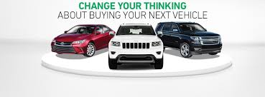
EDA of Car Sales Dataset
by Prasanna Kumar Bhuyan

Slide 2
Exploratory Data Analysis
The presentation explores the basic use of Pandas and will cover the basic commands of Exploratory Data Analysis(EDA) which includes cleaning, munging, combining, reshaping, slicing, dicing, and transforming data for analysis This dataset contains data for more than 9.5K cars sale in Ukraine. Most of them are used cars so it opens the possibility to analyze features related to car operation
Exploratory Data Analysis In the following few slides we have used extensive application of EDA to derive simple models with Pandas as baseline. The following are the different techniques used as part of EDA.
Finding patterns in Data
Determining relationships in Data
Checking of assumptions
Preliminary selection of appropriate models
Detection of mistakes

Slide 3
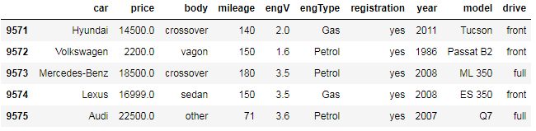
Continued..
Content
Dataset contains 9576 rows and 10 variables with essential meanings:
car: manufacturer brand
price: seller’s price in advertisement (in USD)
body: car body type
mileage: as mentioned in advertisement (‘000 Km)
engV : rounded engine volume (‘000 cubic cm)
engType : type of fuel (“Other” in this case should be treated as NA)
registration: whether car registered in Ukraine or not
year: year of production
model: specific model name
drive: drive type

Slide 4
Problem Statement(Car Sales Dataset)
Car Sales dataset is purely obtained for Study and practice of academically purpose. The car details gathered in this dataset is to be aware of car operations of various car models and engines. The objective is to gather and compare cars and associated operational details using Python and Pandas for analytics gathering exercise. At the outset ,there is an implicit assumption which says unpurified data being fetched onto python notebook before doing processing operations on it.

Slide 5
Understanding & Processing Of Dataset
Understanding of car sales dataset includes importing, loading and ascertaining the basic health check of dataset using various Pandas functionalities.
Profiling of dataset involves transformations of raw data into meaningful analytics container which can then be used for decision making and model building. This comprise of erroneous and missing column values handling along with pre processing and pandas profiling.
Extensive use of data visualization libraries enabled the charts,graphs,crosstabs and different other maps grasping the underlying inference for decision making.
Both preprocessing and pandas after profiling html files are added to deliverables list.

Slide 6
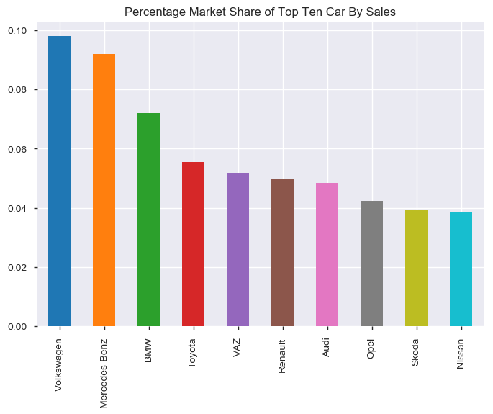
Top Ten car by Sales

Slide 7
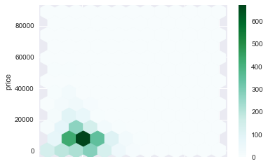
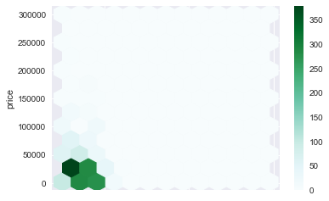
Price vs Mileage comparison Before and After car sales in the year 2010
< 2010
> 2010
Before 2010 cars with lower price have better mileage whereas after 2010 there has been reduction in mileage for even higher priced cars. In other words, With increase in price for same cars there has been reduction in Mileage before and after 2010.

Slide 8
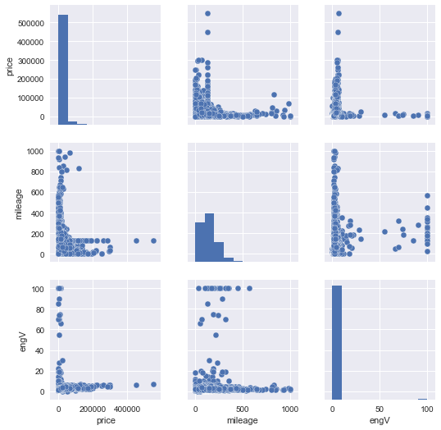
Pair Plot relations
Mileage of low priced cars or models are on higher side.
Lower engine volume cars have strong mileage on their side.

Slide 9
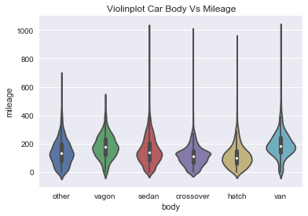
Violin Plot car Body vs Mileage
Most of the mean or average of mileages of car bodies are in the same range with van and vagon having better mileage than rest

Slide 10
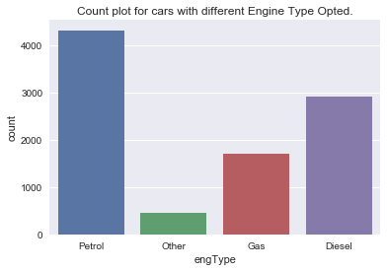
Engine Type distribution among cars
Cars with Petrol engine are most sought after followed by Diesel and Gas.

Slide 11
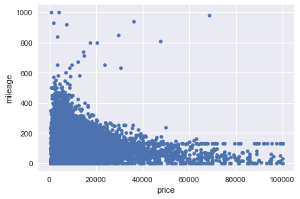
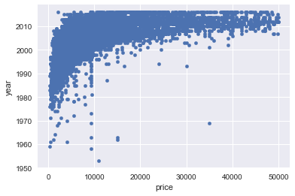
Scatter Plot showing relation between Price vs Mileage & Price vs Year
Car Mileages are mostly concentrated and on the higher side for Low End cars than High end
Prices of cars have increased gradually over the years with most expensive ones are mainly after 2010

Slide 12
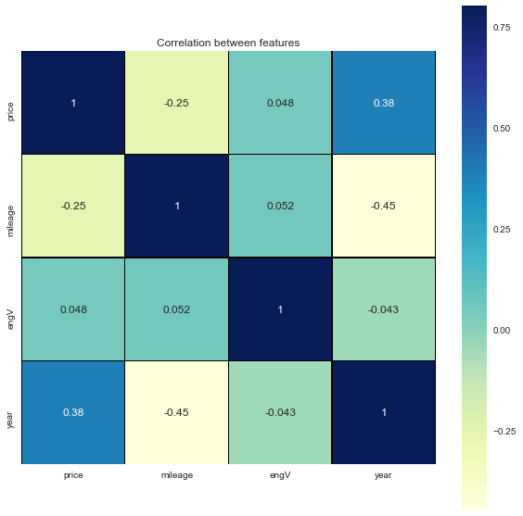
Heatmaps
Mileage is negatively correlated with Price.
Price with Year is having strongest positive correlation.
Engine Volume is having faint negative correlation.
Mileage is having strongest negative relation with increasing year

Slide 13
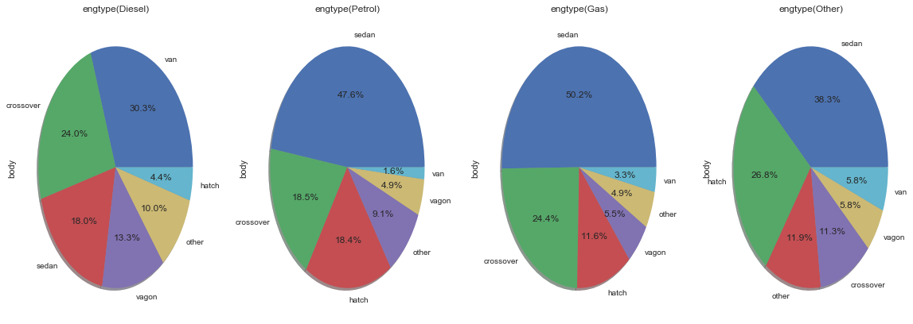
Pie chart –Body Distribution per Engine Type
Vans under diesel Engine Have highest Share of Sales.
Sedans have highest revenue Earner under Petrol, Gas and other Engine Type Segment respectively

Slide 14
Conclusion
how exploratory data analysis can be carried out using Pandas plotting for better visualization and insight.
How preprocessing helps in dealing with missing values and irregularities present in the data.
How pandas profiling feature to generate an html report containing all the information of the various features present in the dataset. This made the task much easier.
How Car types and operational details interrelated among themselves. This creates a whole lot new possibilities in terms of underlying prediction model and pattern making

